Slide 1
Module 2.1
S2 BCOM

Slide 2
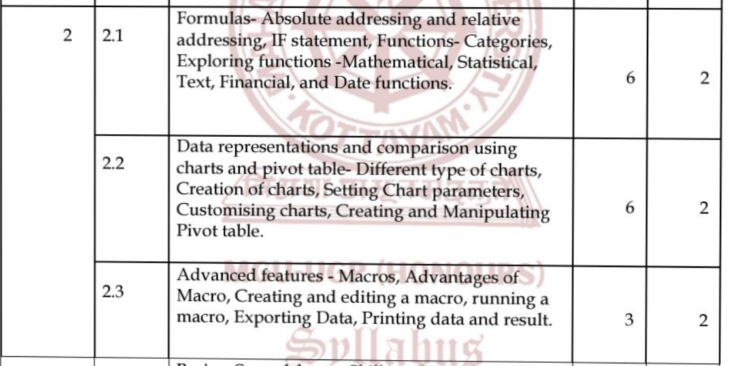

Slide 3
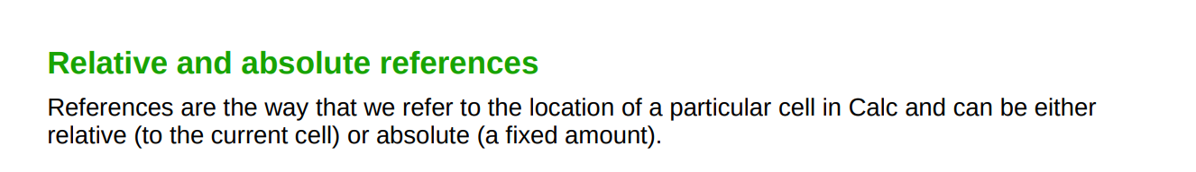
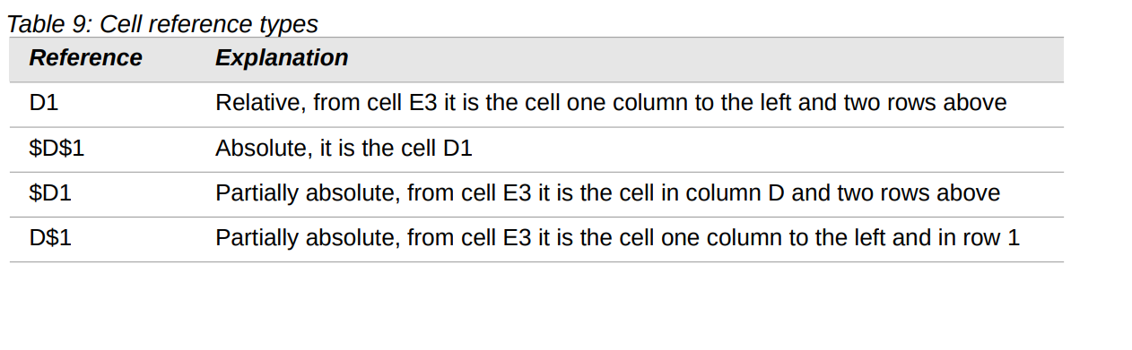

Slide 4
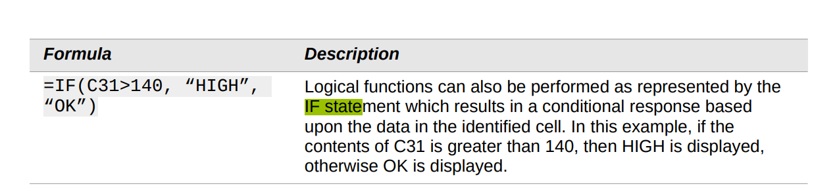
IF STATEMENT

Slide 5
UNDERSTANDING FUNCTIONS
Calc includes over 500 functions to help you analyze and reference data.
Many of these functions are for use with numbers, but others are used with dates and times or even text.
A function may be as simple as adding two numbers together or finding the average of a list of numbers, or it may be as complex as calculating the standard deviation of a sample or a hyperbolic tangent of a number.

Slide 6
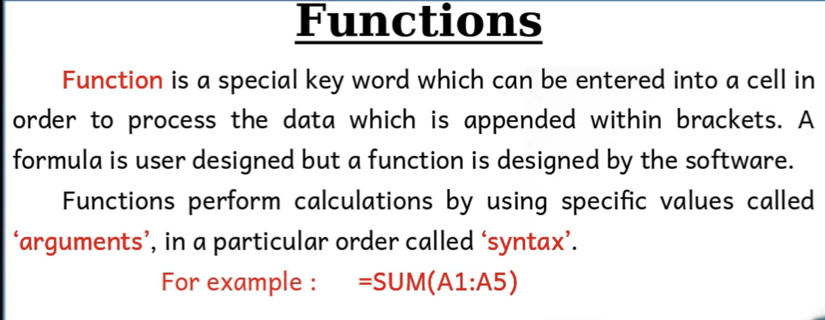

Slide 7
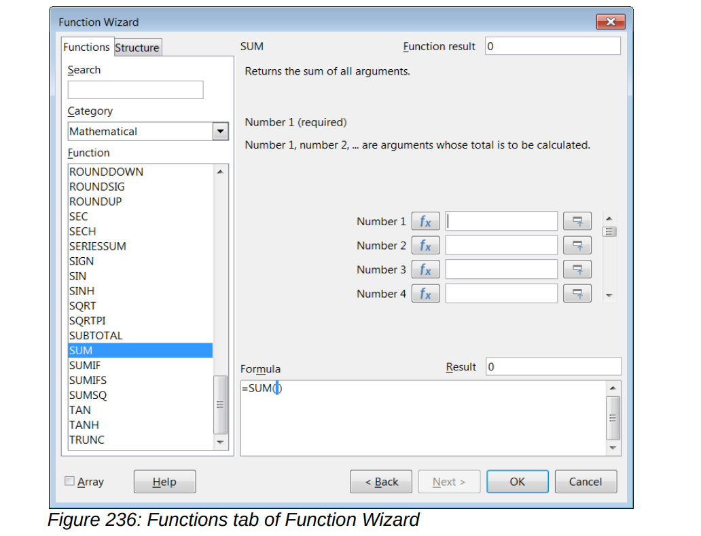
To open it, choose Insert > Function, or click the Function Wizard icon on the Formula Bar, or press Ctrl+F2.

Slide 8
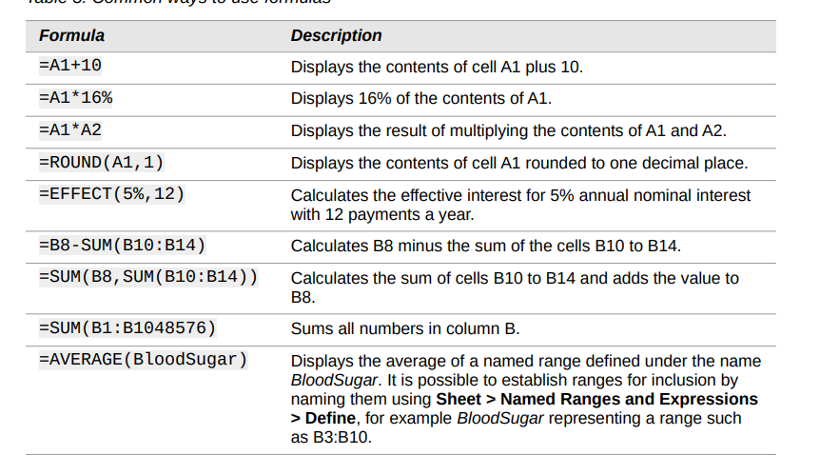

Slide 9
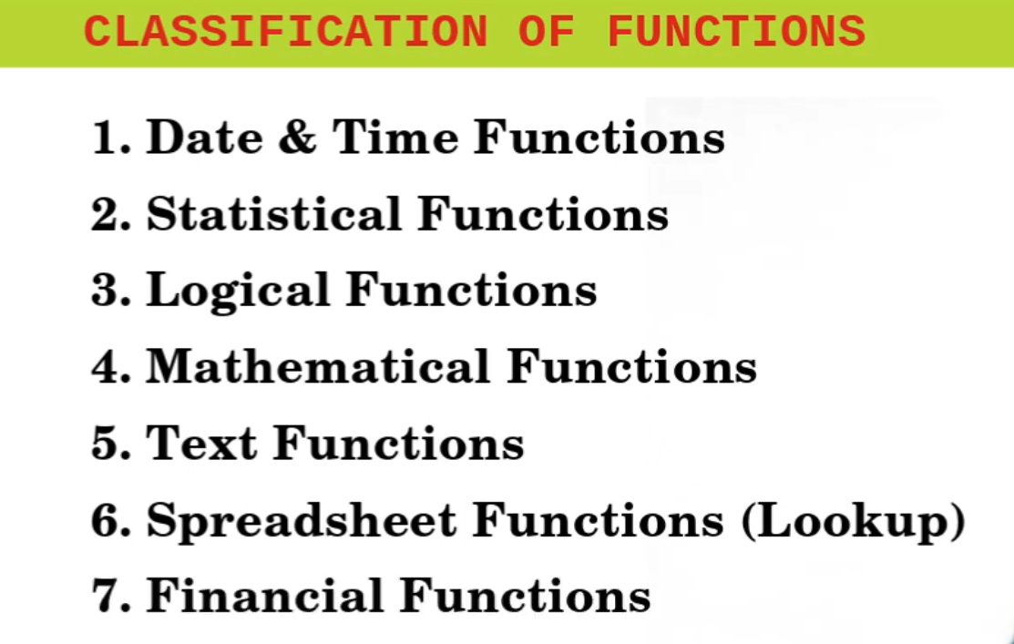

Slide 10
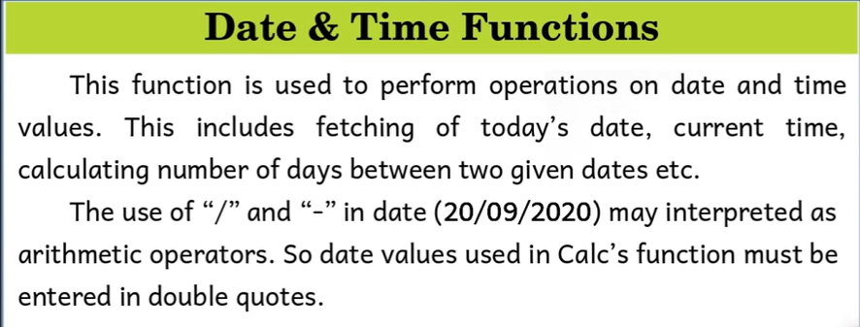

Slide 11
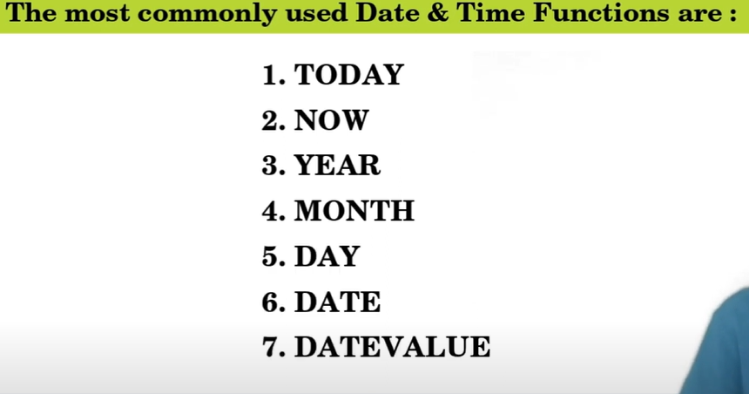

Slide 12
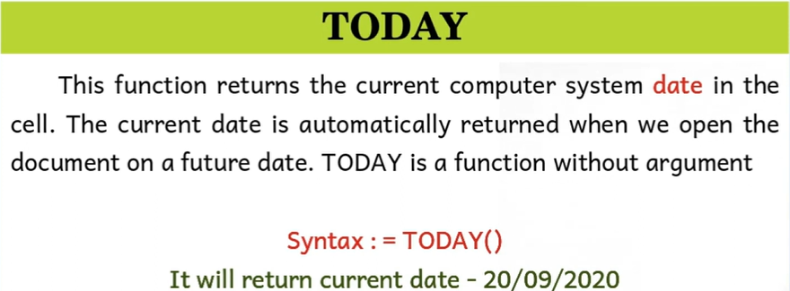

Slide 13
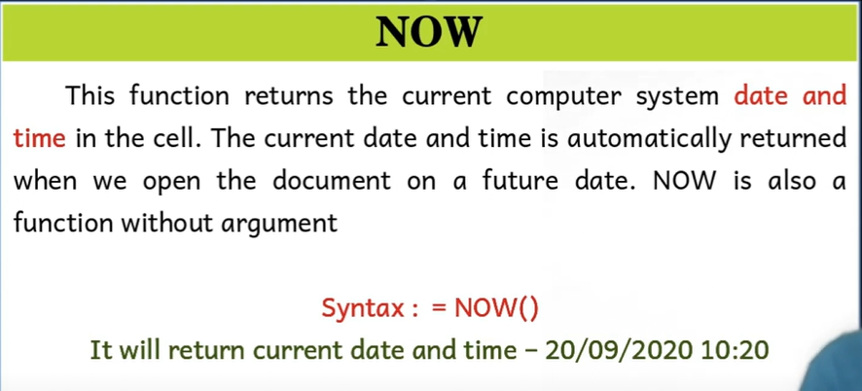

Slide 14
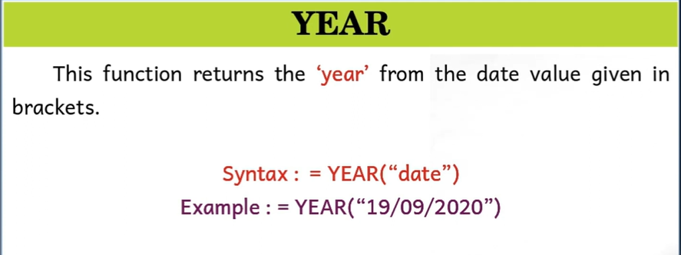

Slide 15
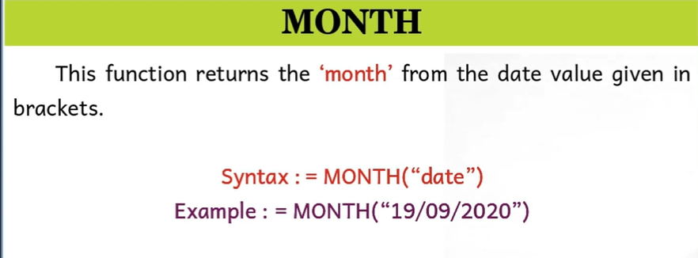

Slide 16
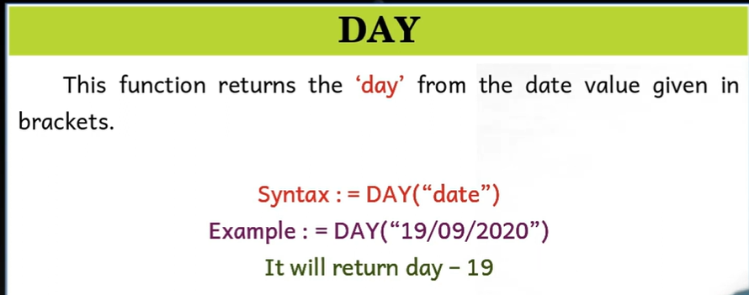

Slide 17
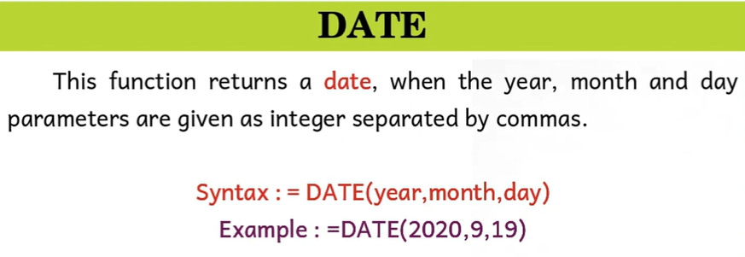

Slide 18
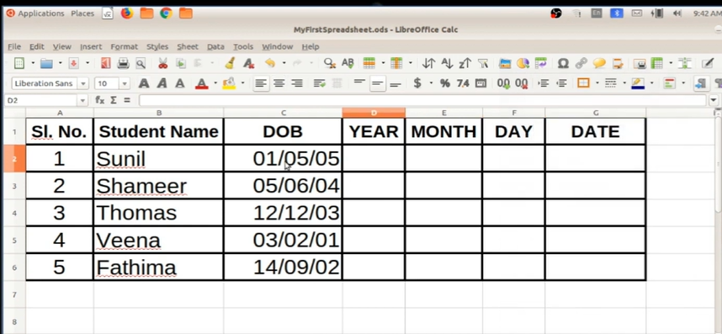
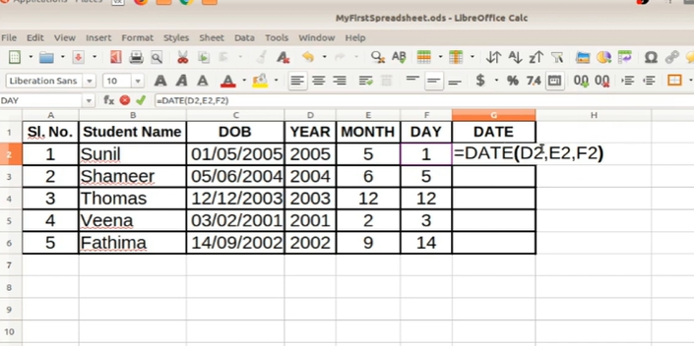

Slide 19
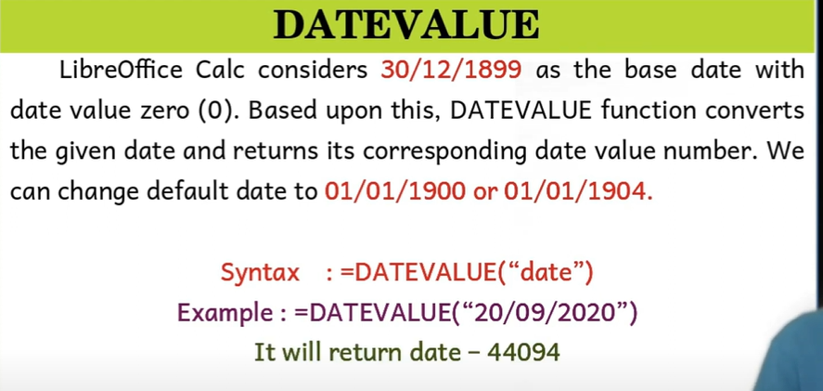
There is an unique value for every date
Mainly to find number of days between two dates
Tools > Options > Libreoffice Calc >Calculate

Slide 20
MATHEMATICAL FUNCTIONS
The following mathematical functions are mainly used in business applications
SUM
SUMIF
ROUND
ROUNDUP
ROUNDDOWN

Slide 21
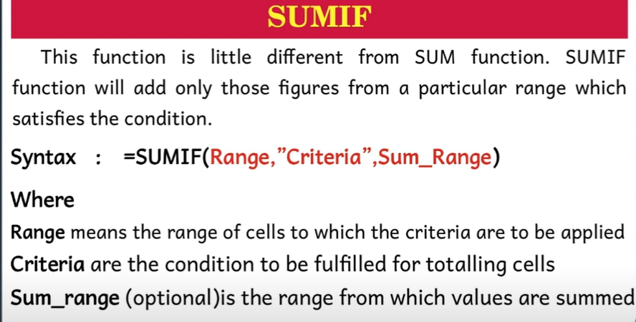

Slide 22
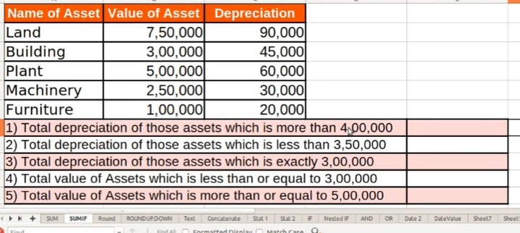
SUMIF FUNCTION
=SUMIF(data_to_test;”>0”;data_to_sum)

Slide 23
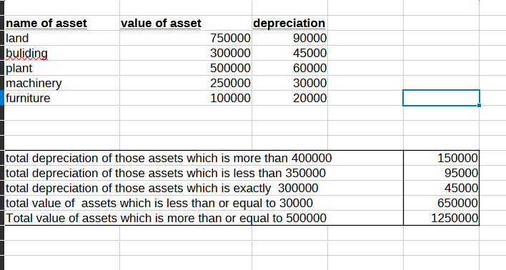
=SUMIF(B3:B7,">400000",C3:C7)
=SUMIF(B3:B7,“<350000",C3:C7)
=SUMIF(B3:B7,“=300000 ",C3:C7)
=SUMIF(B3:B7,“<=300000 ",B3:B7)
=SUMIF(B3:B7,">=500000 “)

Slide 24
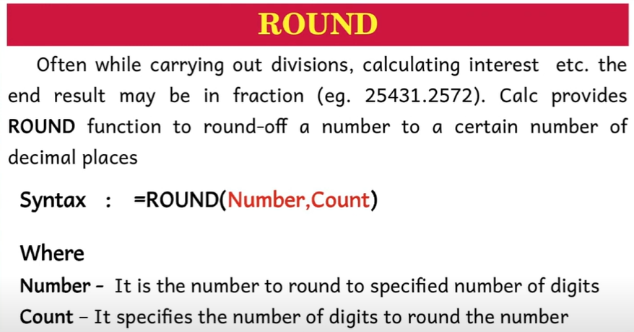
For instance, the formula =ROUND((SUM(A1,A2))

Slide 25
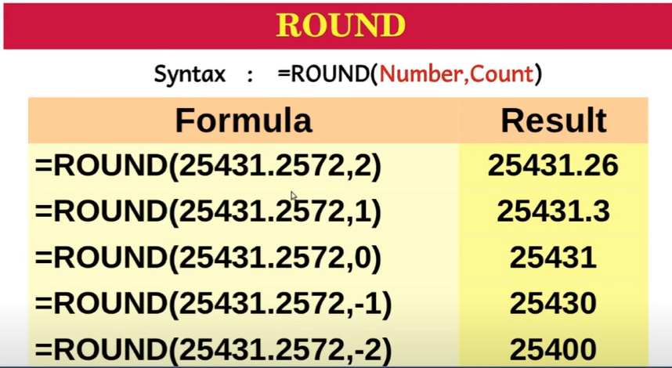

Slide 26
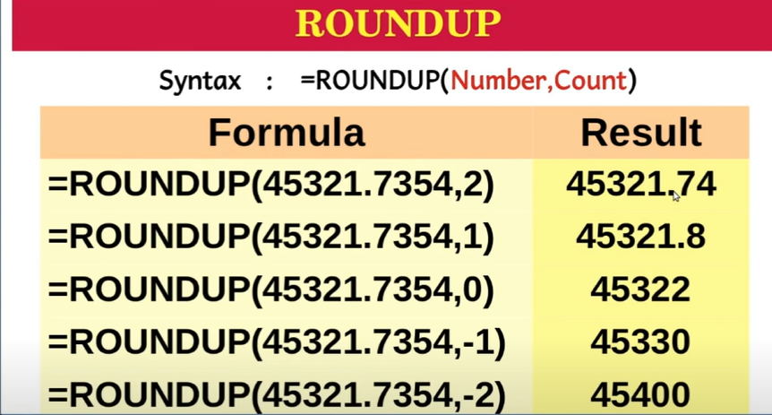

Slide 27
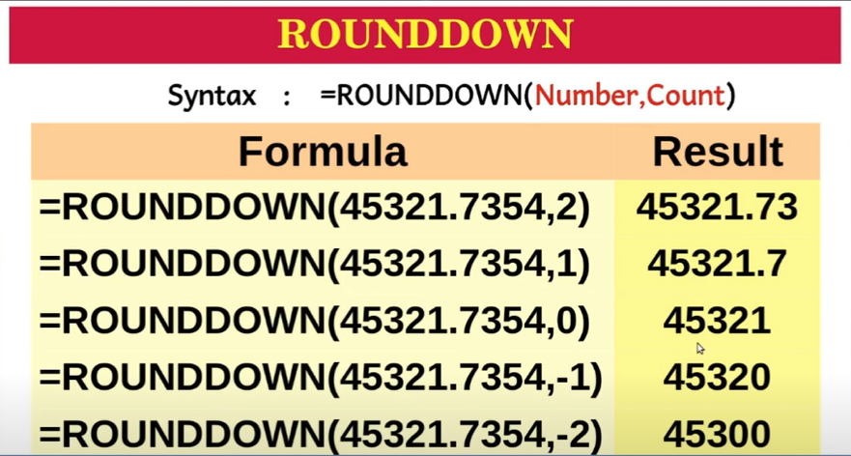

Slide 28
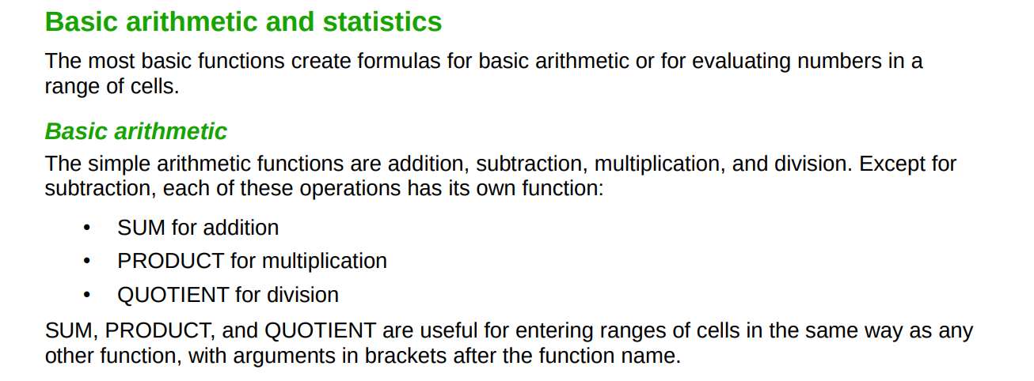

Slide 29
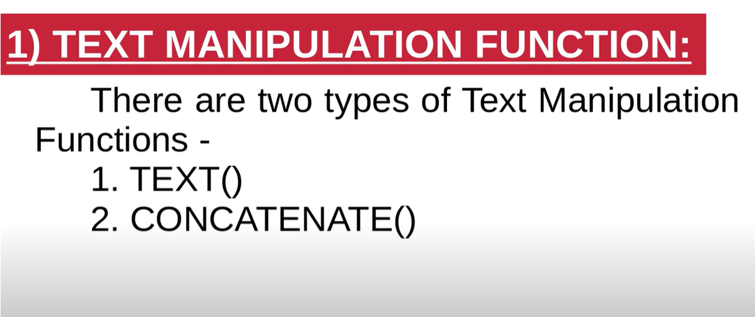

Slide 30
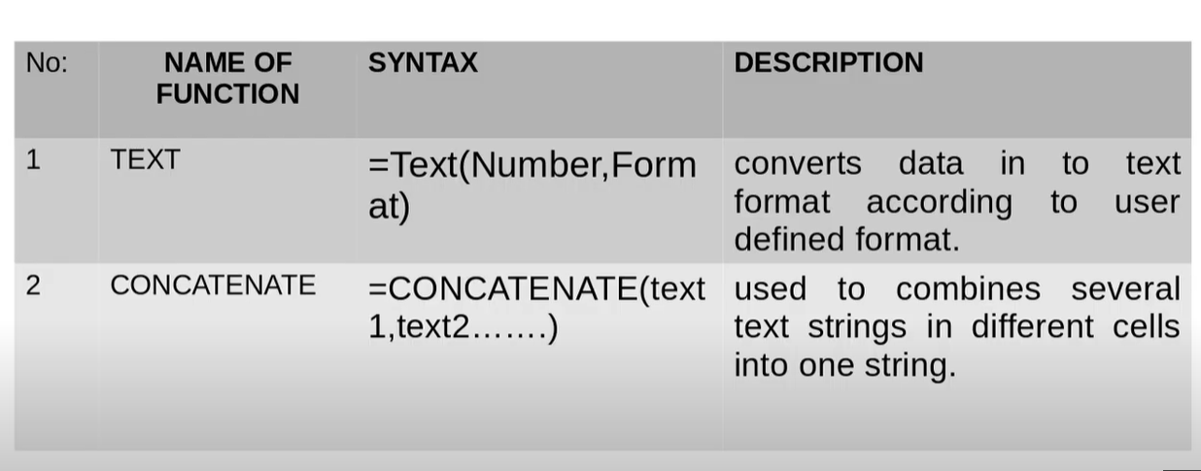

Slide 31
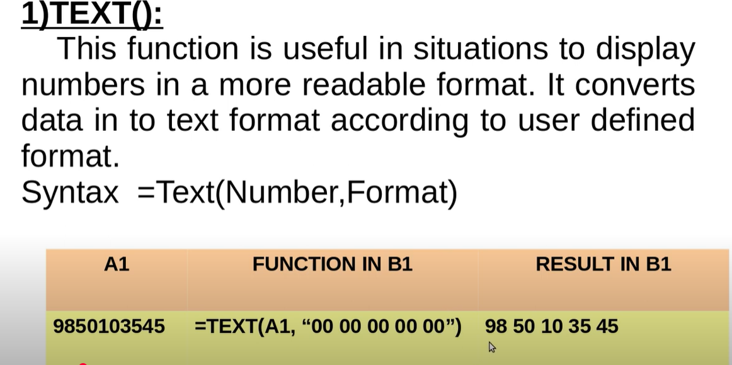

Slide 32
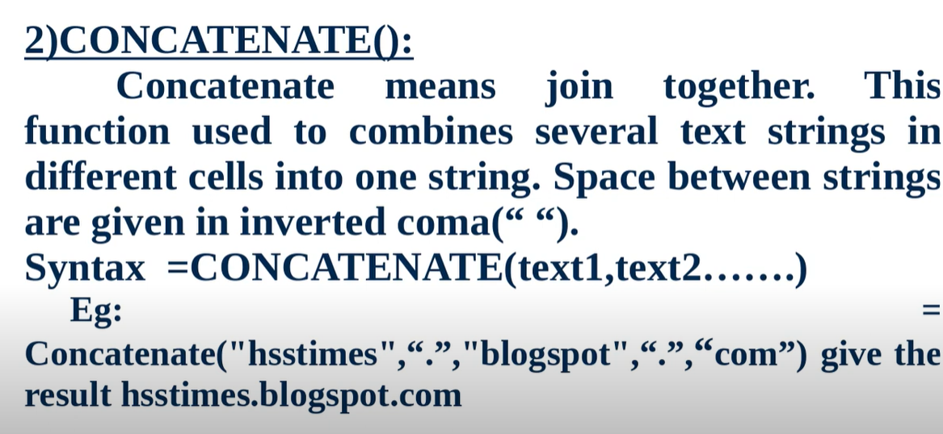
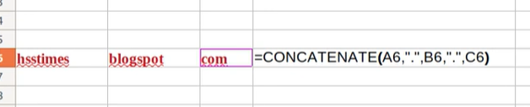

Slide 33
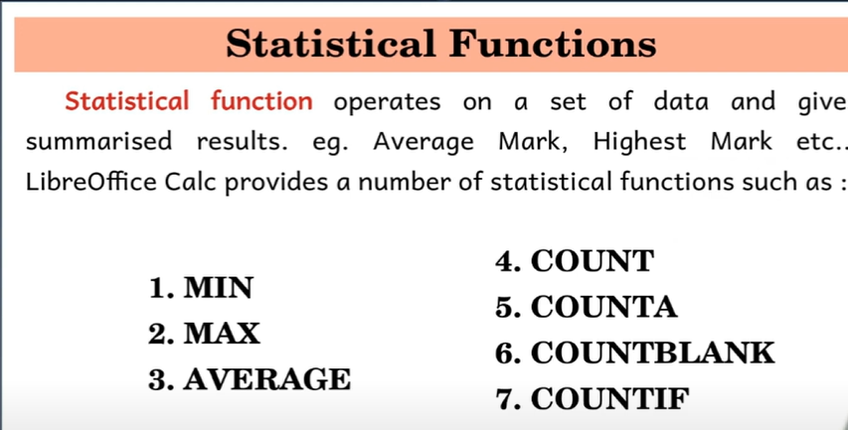

Slide 34
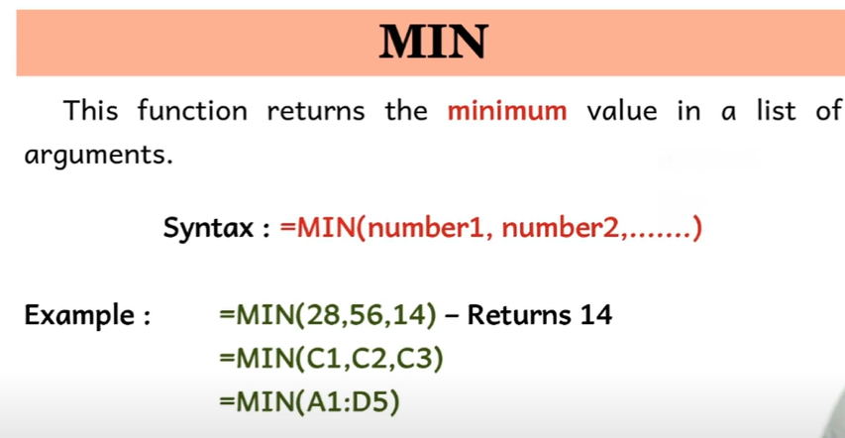

Slide 35
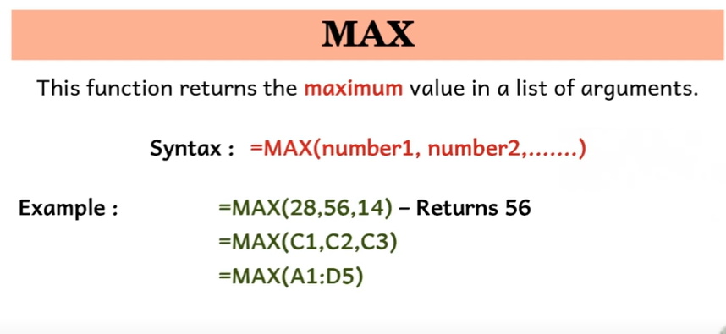

Slide 36
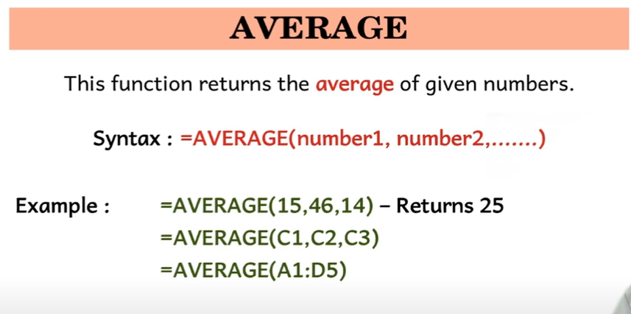

Slide 37
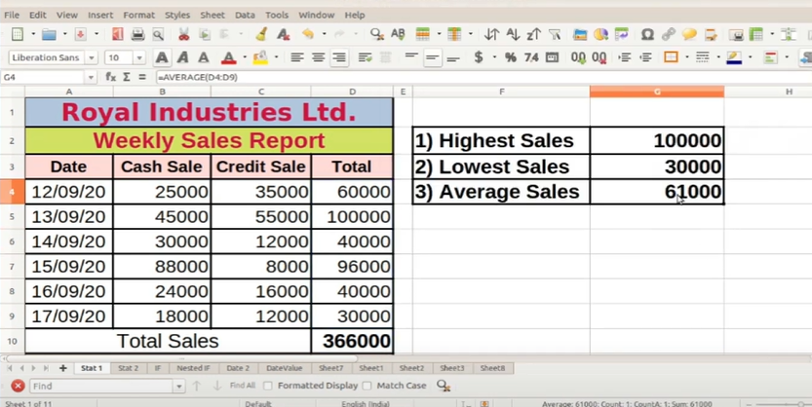

Slide 38
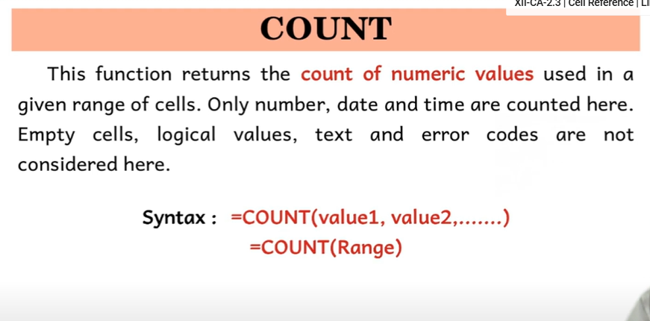

Slide 39
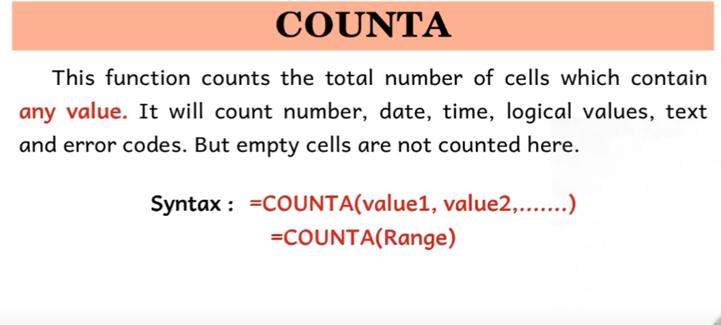

Slide 40
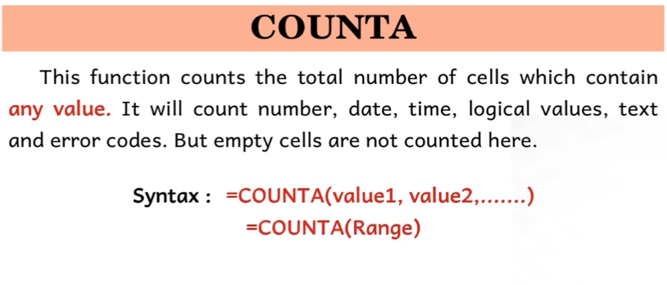

Slide 41
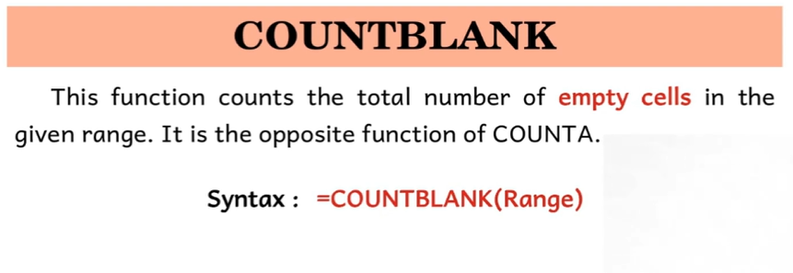

Slide 42
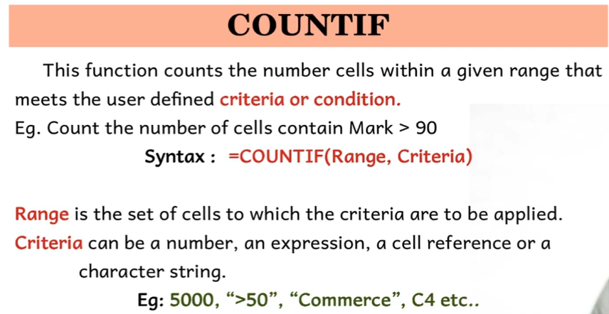

Slide 43
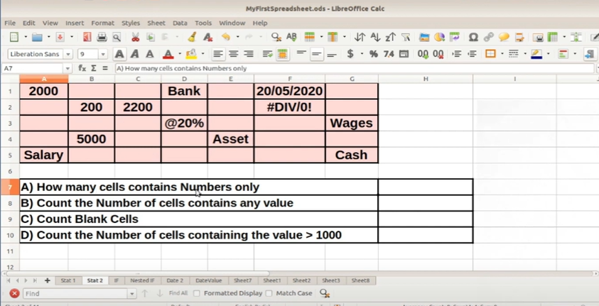

Slide 44
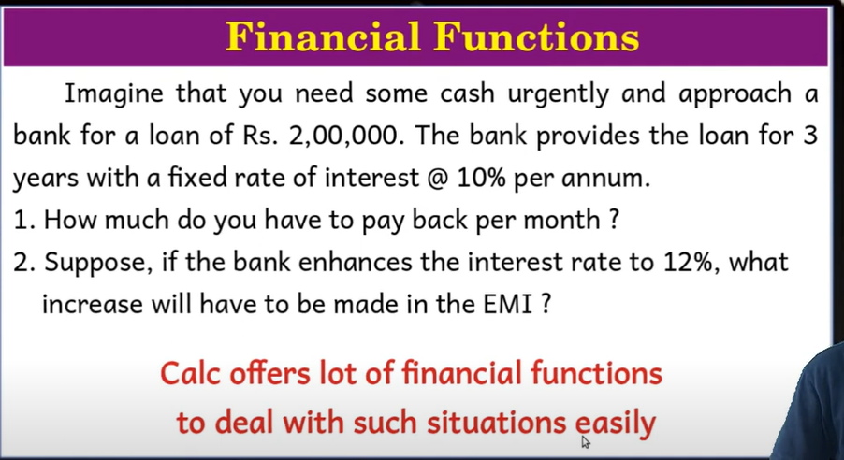

Slide 45
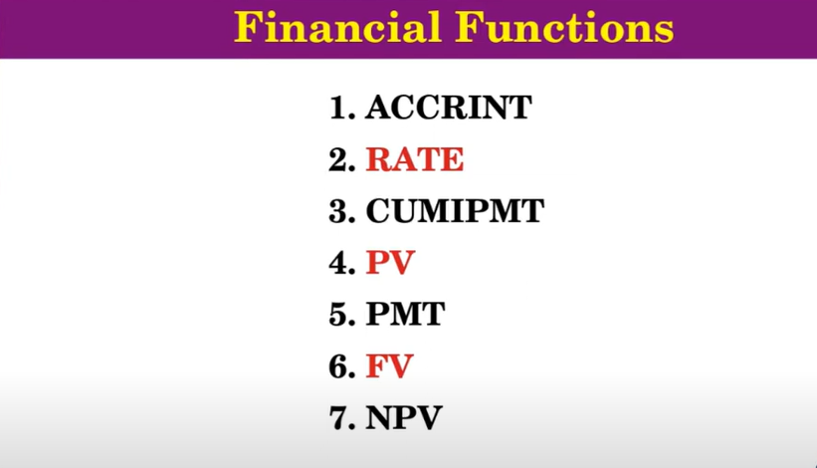

Slide 46
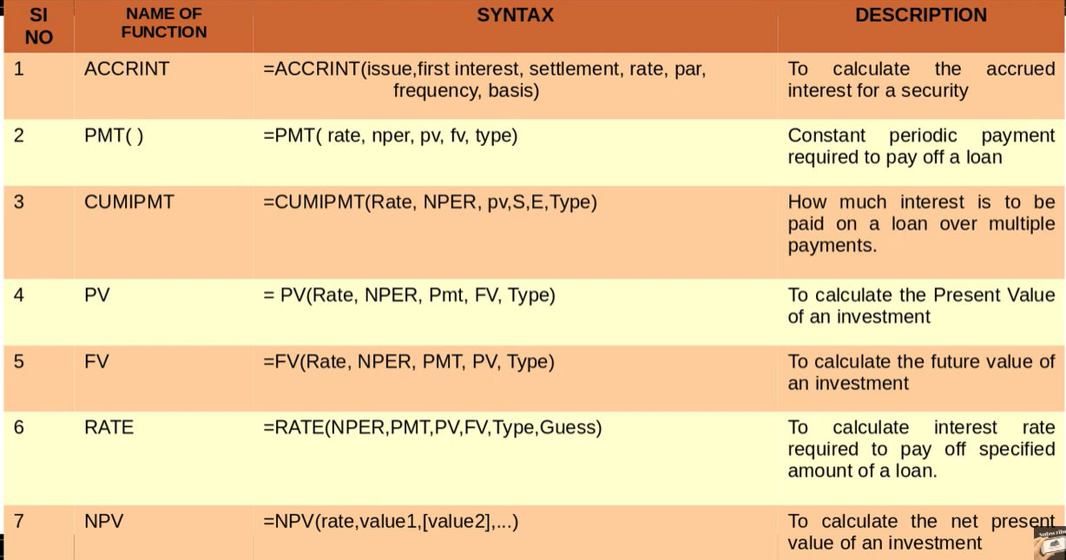

Slide 47
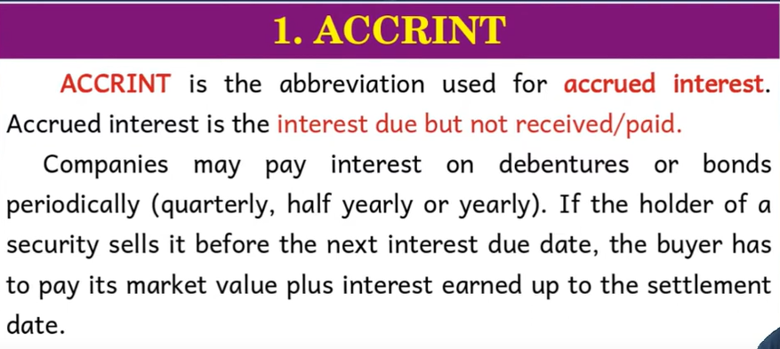

Slide 48
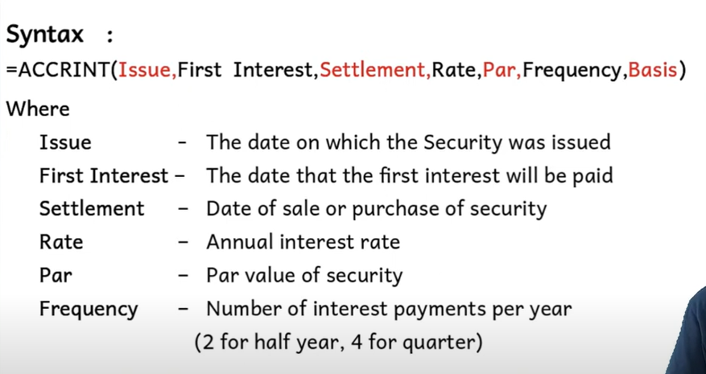

Slide 49
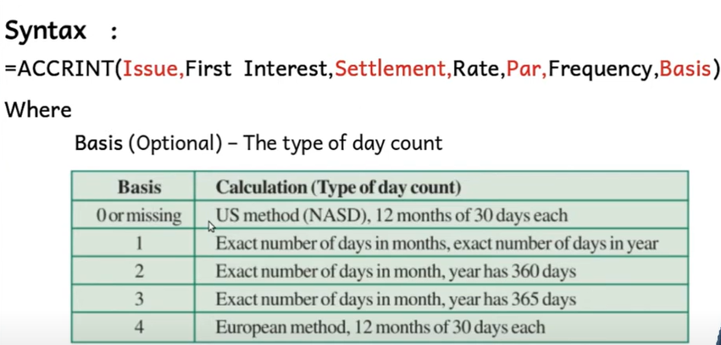

Slide 50
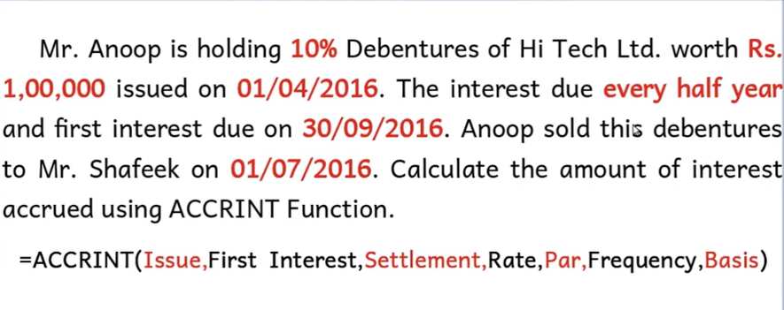

Slide 51



Slide 52


Slide 53


Slide 54


Slide 55


Slide 56


Slide 57

(rate/12)

Slide 58



Slide 59


Slide 60


Slide 61


Slide 62


Slide 63


Slide 64


Slide 66



Slide 67


Slide 68

(Installment
Amount)
(0)

Slide 69



Slide 70


Slide 71


Slide 73


Slide 74



